Slide 1
The American Way
wwwanikulapo.blogspot.com
We pick
Where we work
Whom we live with
Where we shop & what we shop for
How we play
Our government
and
“…[believe] that the sum total of these highly personal decisions will lead to an optimal society…”
Farr 2008

Slide 2
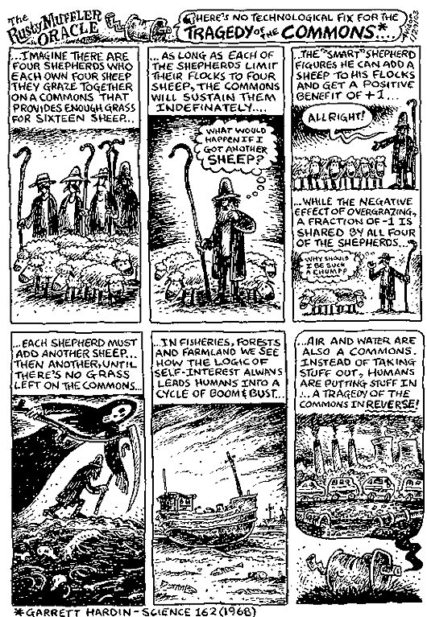
Tragedy of the Commons
www.garretthardinsociety.org
Garret Harding, Science 162 (1969)
Cartoon – The Rusty Oracle

Slide 3
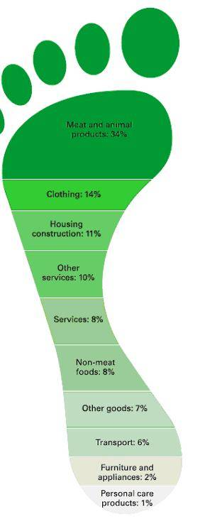
Ecological Footprint
www.greenmi.net/ecological-footprint/

Slide 4
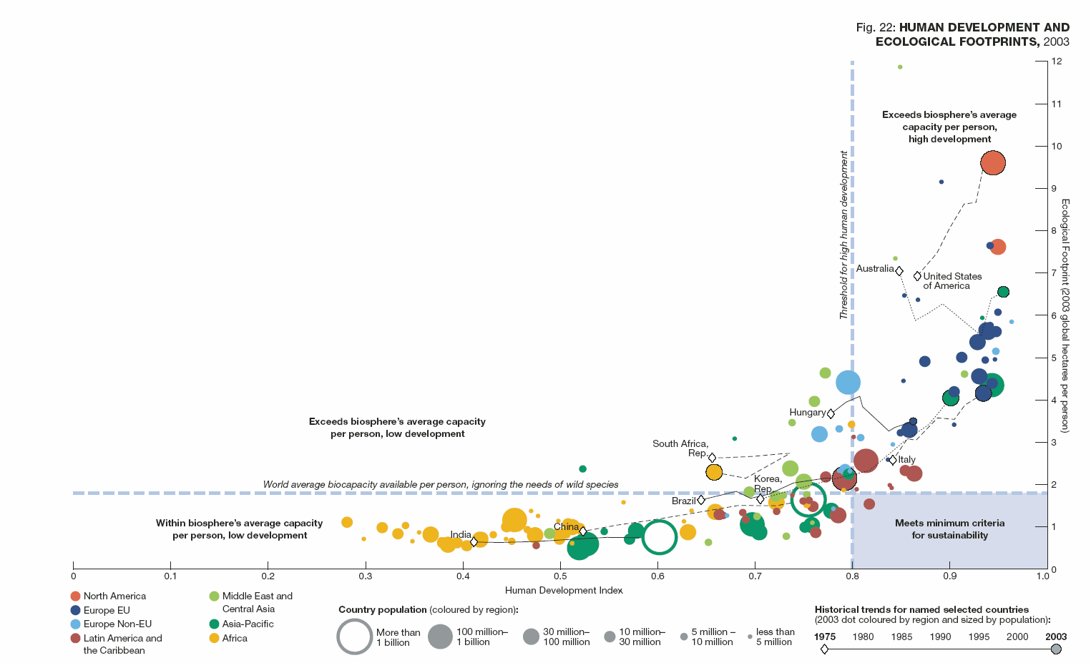
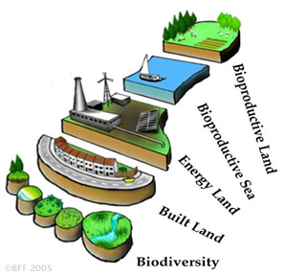
Ecological Footprint & Human Development
ENO (217.149.52.103)
wwf.panda.org

Slide 5
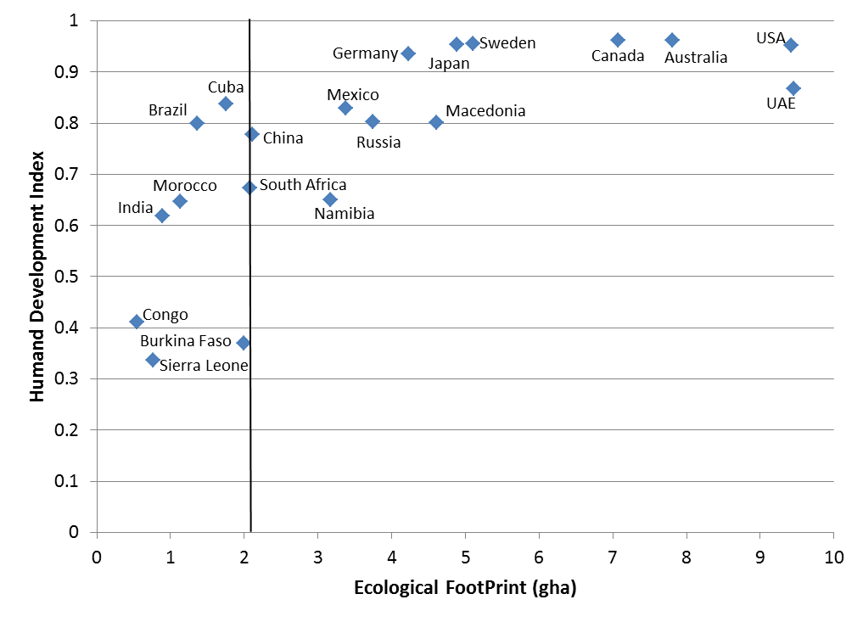
Ecological Footprint versus HDI (2)
Notes:
Ewing , B., S. Goldfinger, M. Wackernagel, M. Stechbart, S. Rizk, A. Reed and J. Kitzes (2008) The Ecological Footprint Atlas (Global Footprint Network, Oakland, CA, USA).
UNDP (2007) Human Development Report 2007/2008 Fighting climate change: Human solidarity in a divided world (UNDP, New York City, New York, USA).

Slide 6
Automobiles
Farr 2008

Slide 7
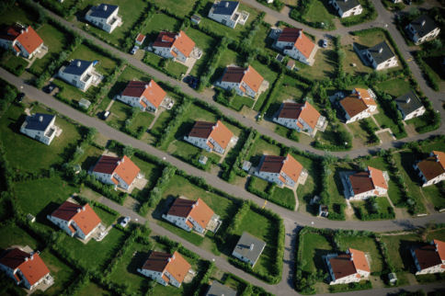
Low Density Development
Land consumption @ ~10 x Population growth
Suburbia!
Farr 2008
chriswiewiora.com

Slide 8
Happiness
Cut off from Nature
Cut off from each other
Right-Sizing US single family home

Slide 9
Health
Health
US: 2006 - 30 % of >20 Population Obese
Indoor air 2 – 5 x more polluted

Slide 10
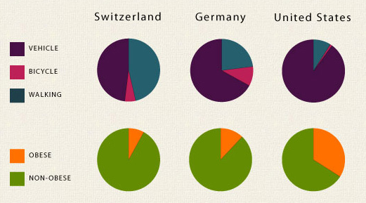
Travel – Travel Mode and Obesity
www.theautoinsurance.com
Annual related medical costs are over $150 B (CDC 2012).

Slide 11
Climate
Human Caused Climate Change
GreenHouse Gases

Slide 12
Sustainable Urbanism
Smart Growth
New Urbanism
USGBC – LEED Certification
US Green Building Council
Leadership in Energy and Environmental Design
Farr 2008

Slide 13
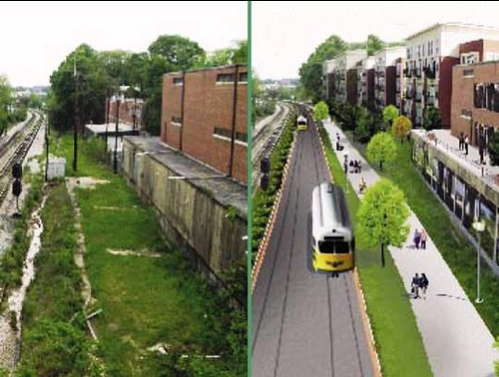
Smart Growth
Farr 2008
www.suffolkcountyny.gov

Slide 14
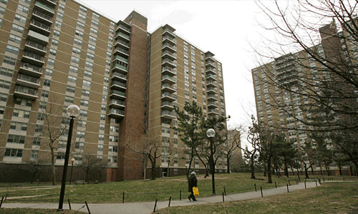
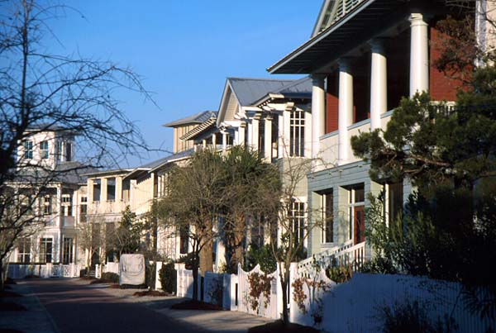
New Urbanism
Farr 2008
Promote Traditional Urbanism
New Approval Techniques
Smart Code (transect-based, form-based)
Regional Planning
Too focused on approval of individual projects
From:
To:
land8.com
www.dkolb.org
Notes:
New Urbanism is a response to the International Congress of Modern Arcitecture movement started in 1928 (attempt to improve health by building towers in parks and designing for automobile, ultimately leading to sprawl and deserted street scapes.

Slide 15
USGBC - LEED
Certifications for Green Buildings and more
Certified to Platinum
Integrated design of systems, rather than components
Improved building envelope → Smaller HVAC
Too few buildings certified
Not enough emphasis on location
LEED – ND is helping
Farr 2008

Slide 16
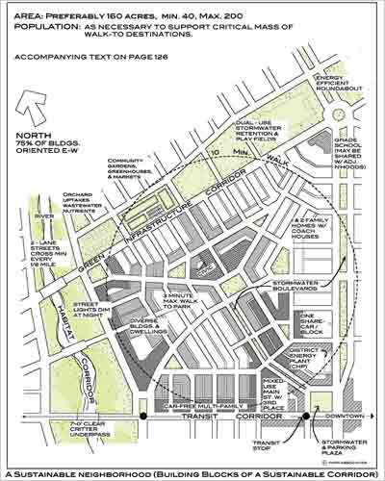
Sustainable Urbanism
Farr 2008
Best of
Smart Growth
New Urbanism
LEED
landscapeandurbanism.blogspot.com

